Slide 1
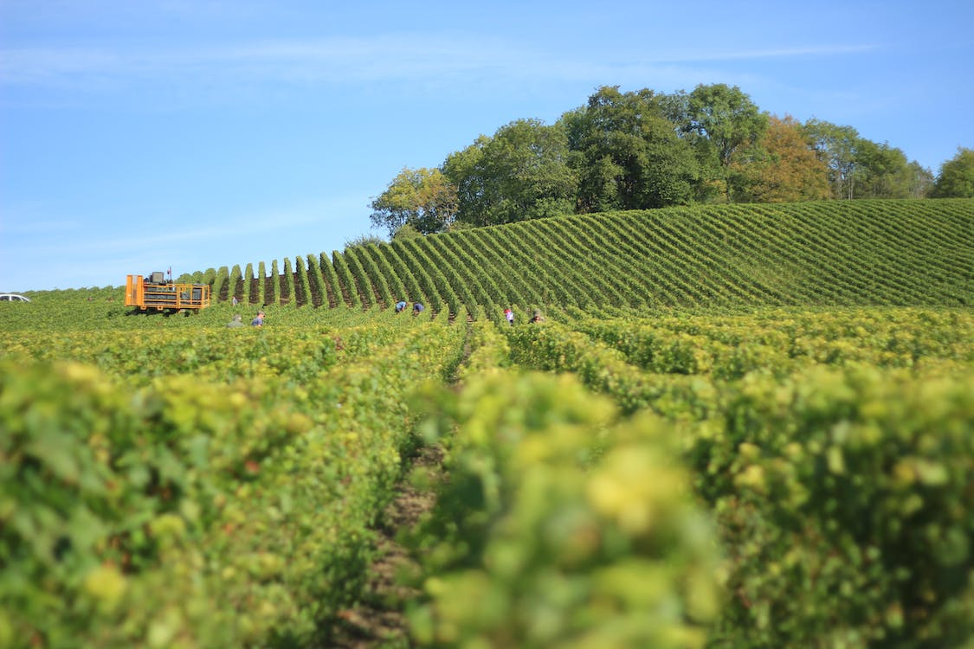



Slide 2
Capstone Project
BUILD AN AGRICULTURAL PRODUCT TRADING SYSTEM
Tran Dang Khoa - 19110145
Pham Viet Anh – 19110151 Nguyen Le Minh Nhut - 19110100
Instructor:
Nguyen Thien Bao

Slide 3
1. PROJECT OBJECTIVE
2. TECHNOLOGIES
3. SYSTEM DESIGN
4. DEMO
5. SUMMARY

Slide 4
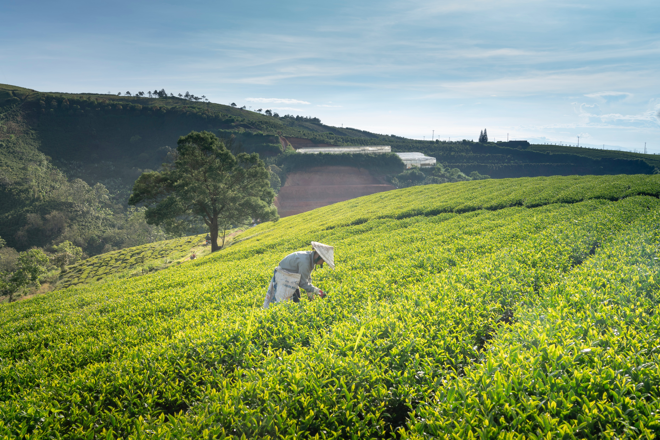


PROJECT OBJECTIVE
Agricultural products are a crucial part of Vietnam's exports.
Traditional distribution channels for agricultural goods involved wholesale marketplaces, purchasing agents, supermarkets, and import-export businesses.
The rise of the digital economy has revolutionized the way agricultural products are sold, with online platforms becoming popular. Consumer demand for quality and safety has also increased.
SYSTEM OF BUYING AND SELLING AGRICULTURAL PRODUCTS
FARMHOME

Slide 5
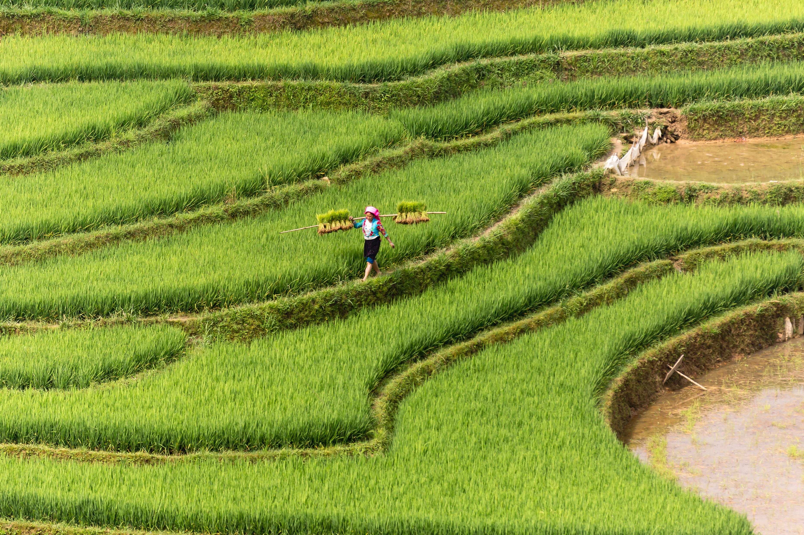

By leveraging technology to build an e-commerce platform, the following objectives can be achieved:
Optimize the process of agricultural product consumption between merchants and farmers.
Simplify and enhance the commercial value by developing mobile applications that allow agricultural producers to directly interact with commercial partners and consumers.
Reduce intermediaries in the trading process.
PROJECT OBJECTIVE
SYSTEM OF BUYING AND SELLING AGRICULTURAL PRODUCTS
Agricultural products are a crucial part of Vietnam's exports.
Traditional distribution channels for agricultural goods involved wholesale marketplaces, purchasing agents, supermarkets, and import-export businesses.
The rise of the digital economy has revolutionized the way agricultural products are sold, with online platforms becoming popular.
FARMHOME
=> Therefore, managers need a more effective communication channel and website/mobile design is the chosen option.
THE OBJECTIVES

Slide 6

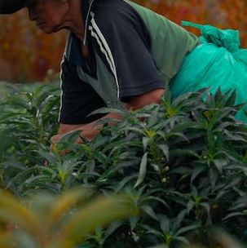
By leveraging technology to build an e-commerce platform, the following objectives can be achieved:
Optimize the process of agricultural product consumption between merchants and farmers.
Simplify and enhance the commercial value by developing mobile applications that allow agricultural producers to directly interact with commercial partners and consumers.
Reduce intermediaries in the trading process.
SITUATION
SYSTEM OF BUYING AND SELLING AGRICULTURAL PRODUCTS
Agricultural products are a crucial part of Vietnam's exports.
Traditional distribution channels for agricultural goods involved wholesale marketplaces, purchasing agents, supermarkets, and import-export businesses.
The rise of the digital economy has revolutionized the way agricultural products are sold, with online platforms becoming popular. Consumer demand for quality and safety has also increased.
FARMHOME
THE OBJECTIVES
=> Therefore, managers need a more effective communication channel and website/mobile design is the chosen option.
EXPECTED RESULTS
Topic “BUILD A SYSTEM TO TRADE AGRICULTURAL PRODUCTS” serves following purposes:
Building a website for farmers can management their products as well as orders.
Building a mobile application for merchants can find and trade agricultural products with farmers.
Building a data management website for admin.
Building a system of buying and selling agricultural products between merchants and farmers with a user-friendly interface, easy to use.

Slide 7

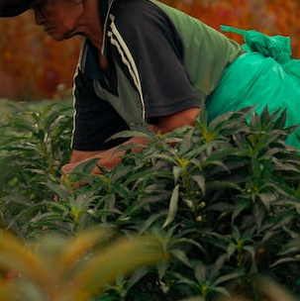





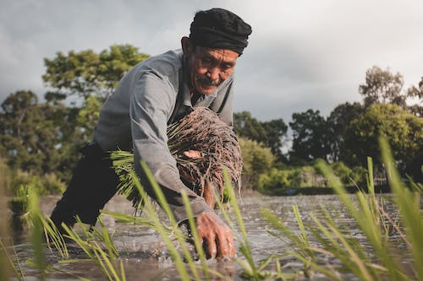
EXPECTED RESULTS
TECHNOLOGIES
By leveraging technology to build an e-commerce platform, the following objectives can be achieved:
Optimize the process of agricultural product consumption between traders and farmers.
Simplify and enhance the commercial value by developing mobile applications that allow agricultural producers to directly interact with commercial partners and consumers.
Reduce intermediaries in the trading process, facilitating direct connections between traders and farmers.
Topic “BUILD A SYSTEM TO TRADE AGRICULTURAL PRODUCTS” serves following purposes:
Building a website for farmers can management their products as well as orders.
Building a mobile application for merchants can find and trade agricultural products with farmers.
Building a data management website for admin.
Building a system of buying and selling agricultural products between merchants and farmers with a user-friendly interface, easy to use.
Angular
React Native
ReactJS
MySQL database
Spring Boot
THE OBJECTIVES
EXPECTED RESULTS

Slide 8
THE EXPECTATION
*Object and scope of the study
TECHNOLOGIES
The main points can be summarized as follows:
The investigation involved two focus groups: one with prior knowledge of technology and one without.
The research covered various technical knowledge areas, including Angular, React Native, MySQL database, Spring Boot, and a brief application on TensorFlow.
The study aimed to outline the main objectives and apply the knowledge points to the final product, without focusing extensively on irrelevant theories.
Angular
React Native
ReactJS
MySQL database
Spring Boot

Slide 9
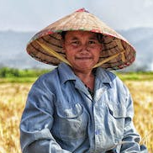

Login to the website
Add agricultural products
Farmers
Receive orders
History
Accept
Decline
Done
Orders
Discuss
Create orders
Find agricultural products
New request
Merchant
Login to the mobile app

Slide 10
MERCHANT
FARMER
- Login/Register
- Manage profile
- View the list of agricultural products
- View the farmers
- Search
- Orders
- Decision final deal price (if have)
- Delete the ordered agricultural product
- See the list of ordered agricultural products
- Login/Register
- Manage profile
- Manage agricultural products
- Validate agricultural orders (Accept/Discuss/Decline)
- View agricultural products’ orders
- Deal new agricultural products’s price
ACTORS AND USECASES

Slide 11

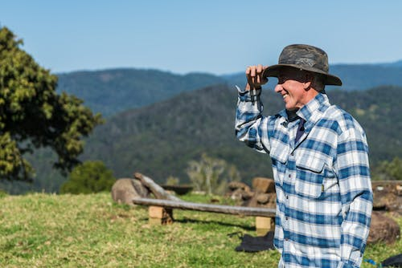
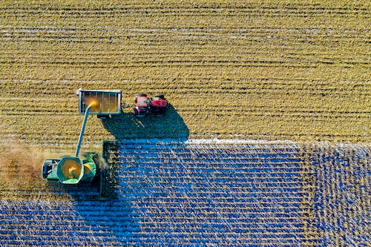
ACHIEVED RESULT
About knowledge and skills:
• Backend development with Java, Spring Boot, and Python enables API creation for frontend and mobile applications, covering programming concepts, web development skills, and database connectivity.
• Students also gain knowledge in deployment, cloud platforms, machine learning/AI, and debugging.
• The system utilizes JavaScript, Typescript, SASS/SCSS, React JS, React Native, and Angular with material design to develop dynamic admin pages, farmer websites, and merchant mobile apps.
Demo
FARMHOME

Slide 12
ACHIEVED RESULT
About knowledge and skills:
• Backend development with Java, Spring Boot, and Python enables API creation for frontend and mobile applications, covering programming concepts, web development skills, and database connectivity.
• Students also gain knowledge in deployment, cloud platforms, machine learning/AI, and debugging.
• The system utilizes JavaScript, Typescript, SASS/SCSS, React JS, React Native, and Angular with material design to develop dynamic admin pages, farmer websites, and merchant mobile apps.

Slide 13
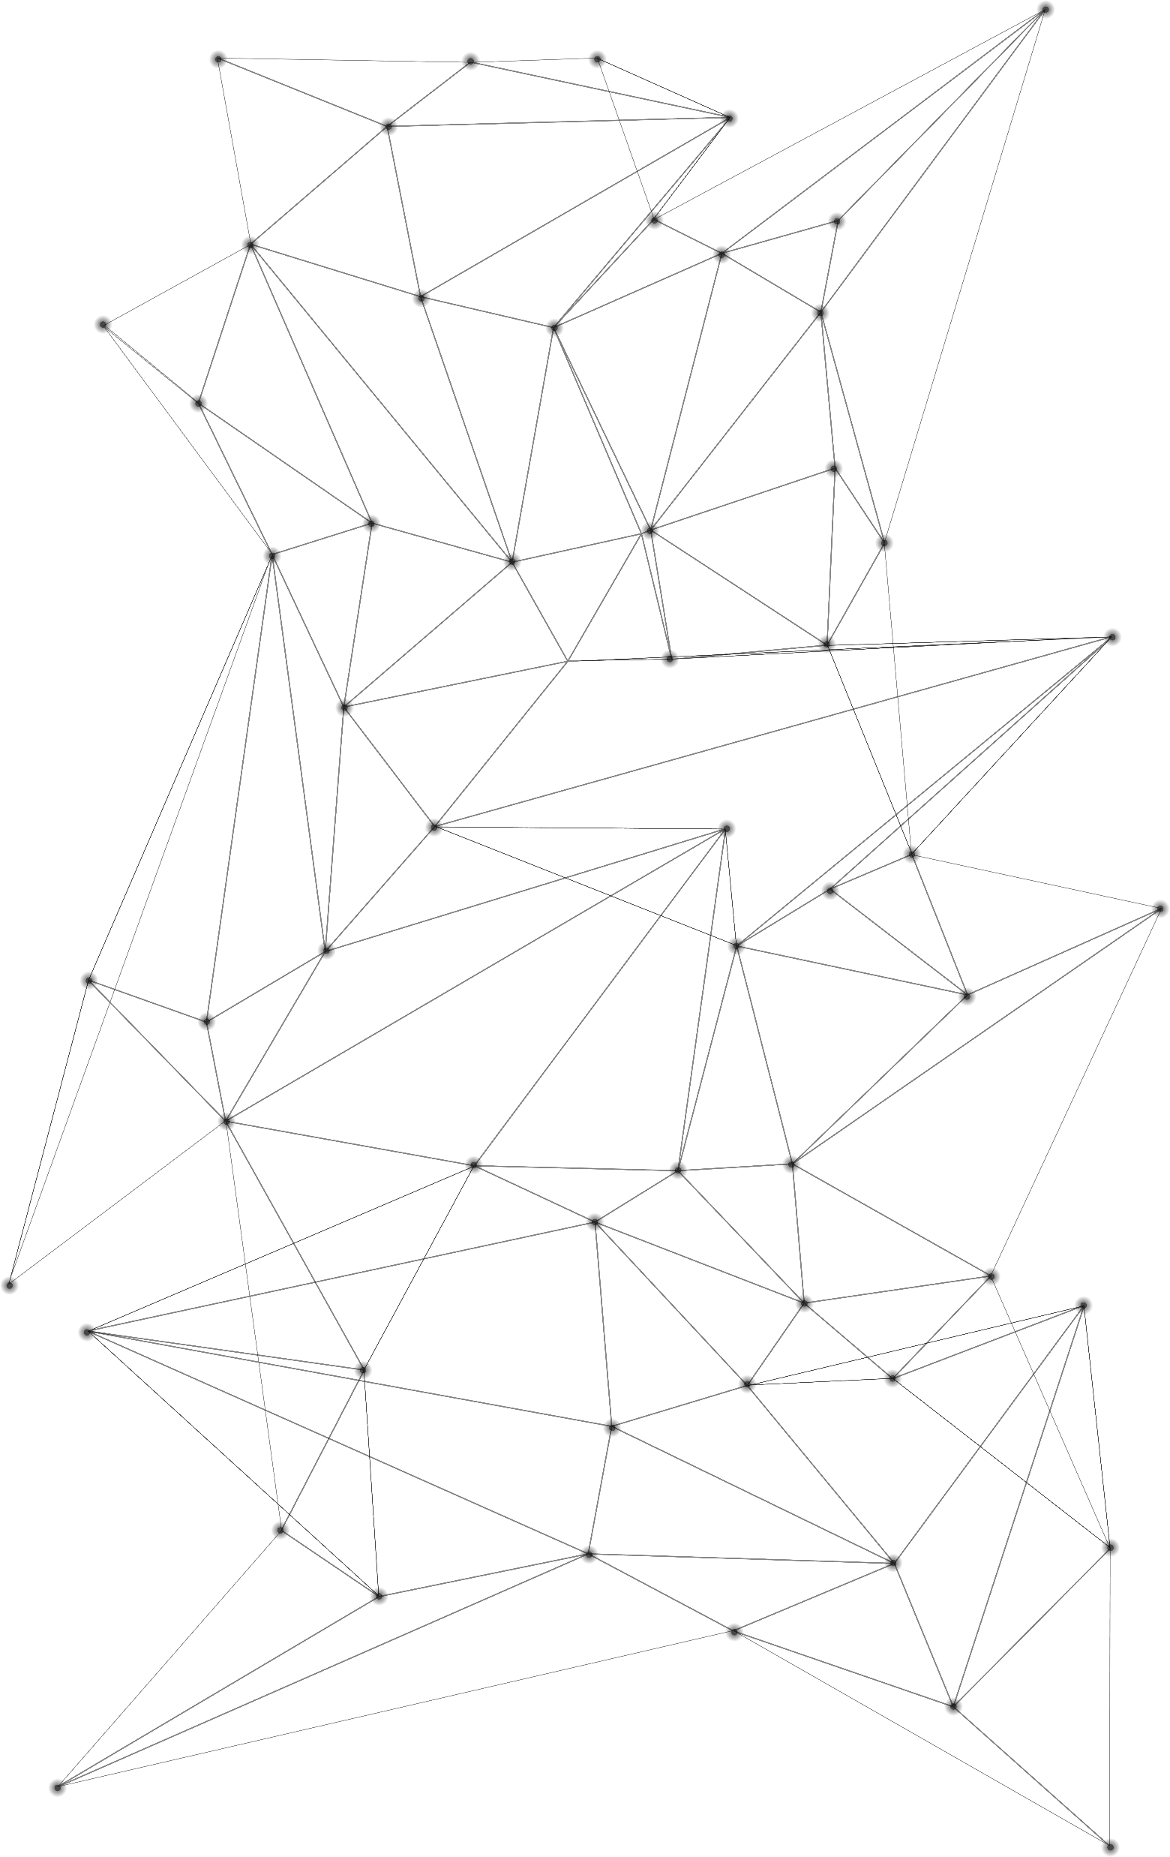

ACHIEVED RESULT
The system:
• The backend program ensures the fulfillment of required APIs for frontend and mobile applications.
• The admin website includes features for user monitoring, management, product and category management, and sales data analytics.
• The mobile app caters to merchants, allowing them to view and order products, as well as access additional features like chat, information updates, and news reading. Notifications are sent for important events.
• The website supports farmers in managing agricultural products and orders. Users can log in, update product information, and handle orders, including viewing and confirming them.
STRENGTHS
The system incorporates seamless file uploading, internet-based hosting, an agricultural detection model, and thorough error testing.
The interface is improved based on instructor feedback for wider user suitability. Statistical indicators are carefully sourced and consulted with experts. Optimizing simple functions maximizes efficiency and effectiveness.
Contains the basic functions used for trading argicultural products in the “Merchant” and “Farmer” side.

Slide 14
ACHIEVED RESULT
STRENGTHS
The system:
The backend program ensures the fulfillment of required APIs for frontend and mobile applications.
The admin website includes features for user monitoring, management, product and category management, and sales data analytics.
The mobile app caters to merchants, allowing them to view and order products, as well as access additional features like chat, information updates, and news reading. Notifications are sent for important events.
The website supports farmers in managing agricultural products and orders. Users can log in, update product information, and handle orders, including viewing and confirming them.
The system incorporates seamless file uploading, internet-based hosting, an agricultural detection model, and thorough error testing.
The interface is improved based on instructor feedback for wider user suitability.
Contains the basic functions used for trading argicultural products in the “Merchant” and “Farmer” side.

Slide 15
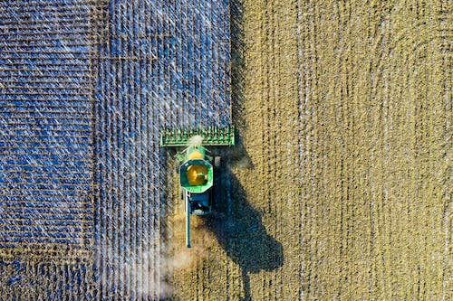
STRENGTHS
There will be some functions that used to support for the trading.
Collecting data to show the price to the users so they can know about the price in the market right now.
Notifications will be sent to the user’s phone to make sure they will notice when there is an event to their orders.
Fruit detection helps users identify different types of fruits, facilitating the easy recording of information through images using a pre-trained model.
The system incorporates seamless file uploading, internet-based hosting, an agricultural detection model, and thorough error testing.
The interface is improved based on instructor feedback for wider user suitability.
Contains the basic functions used for trading argicultural products in the “Merchant” and “Farmer” side.
DRAWBACKS
• The current system lacks some features such as message, language switching, notification in website, not support for IOS right now in mobile, social media login, etc…
• In real-world scenarios, there may be instances where certain features are missing or insufficient, which can present challenges for users.
• The absence of a dedicated reference price management feature for farmers complicates the process of setting competitive prices based on reliable market references.

Slide 16
FUTURE DEVELOPMENTS
Improve the limitations that have not been reached.
To accommodate future development, potential APIs can be integrated to introduce functionalities like social media login, rating, commenting, and more.
Introducing a super admin role to facilitate systematic management of other admins would be a valuable improvement.
Creating a better business for circulation economy.
Supporting for more options when delivering.
STRENGTHS
DRAWBACKS
There will be some functions that used to support for the trading.
Collecting data to show the price to the users so they can know about the price in the market right now.
Notifications will be sent to the user’s phone to make sure they will notice when there is an event to their orders.
Fruit detection helps users identify different types of fruits, facilitating the easy recording of information through images using a pre-trained model.
• The current system lacks some features such as message, language switching, notification in website, not support for IOS right now in mobile, social media login, etc…
• In real-world scenarios, there may be instances where certain features are missing or insufficient, which can present challenges for users.
• The absence of a dedicated reference price management feature for farmers complicates the process of setting competitive prices based on reliable market references.

Slide 17
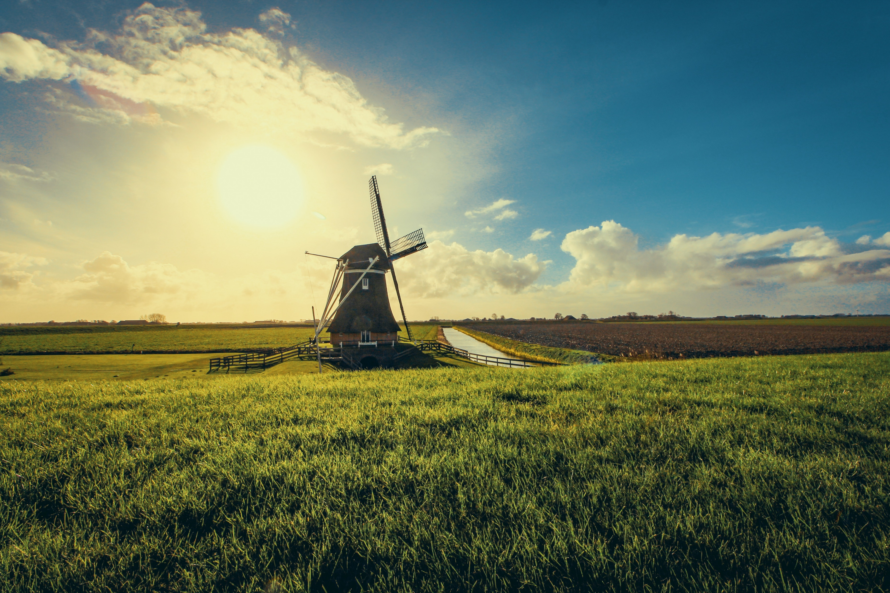
FUTURE DEVELOPMENTS
Improve the limitations that have not been reached.
To accommodate future development, potential APIs can be integrated to introduce functionalities like social media login, rating, commenting, and more.
Introducing a super admin role to facilitate systematic management of other admins would be a valuable improvement.
Creating a better business for circulation economy.
Supporting for more options when delivering.
THANK YOU FOR WATCHING
DRAWBACKS
In real-world scenarios, there may be instances where certain features are missing or insufficient, which can present challenges for users.
Limited advanced permission management features may compromise system security and control by hindering effective user role and access level management.
The absence of a dedicated reference price management feature for farmers complicates the process of setting competitive prices based on reliable market references.

Slide 18


FUTURE DEVELOPMENTS
THANK YOU FOR WATCHING
Improve the limitations that have not been reached.
To accommodate future development, potential APIs can be integrated to introduce functionalities like social media login, rating, commenting, and more.
Introducing a super admin role to facilitate systematic management of other admins would be a valuable improvement.
Creating a better business for circulation economy (solutions for farmer to solve the bad harvest problems, solving the damaged products problems)
Supporting for more options when delivering (providing warehouses for merchant to save, choosing a third-party delivering service)

